Slide 1
Terminology
Brief, huge recap ☺

Slide 2
BELLWORK
Describe the motions IN YOUR OWN WORDS!
Flexion
Extension
Adduction
Abduction
Rotation

Slide 3
Terminology-Anatomical Position
Anatomical Position
Erect stance
Arms at the sides
Palms facing forward

Slide 4
Terminology-Anatomical Position
THINK-PAIR-SHARE
Why do you think it is important to understand & use anatomical position?

Slide 5
Terminology-Anatomical Planes
Frontal or Coronal Plane:
Divides the body into front & back parts
Everything in FRONT of & in BACK of your ears!

Slide 6
Terminology-Anatomical Planes
Mid-Sagittal or Median Plane
Divides the body into equal left & right parts
Sagittal Plane
Divides the body into un-equal left & right parts

Slide 7
Terminology-Anatomical Planes
Transverse Plane
Divides the body into top & bottom parts

Slide 8
Terminology-Anatomical Planes
Frontal/Coronal Plane
Divides the body into front & back parts
Sagittal Plane
Divides the body into unequal left & right parts
Mid-Sagittal/Median Plane
Divides the body into equal left & right parts
Transverse Plane
Divides the body into top & bottom parts

Slide 9
Table Talk!
Together in your groups, come up with at least two body parts in each anatomical plane.
After three minutes, each table will present their work, but listen closely!
Try not to repeat any answers! You’ll have to QUIETLY change any answers as needed.

Slide 10
Terminology-Anatomical Directions
Anterior
Toward the front of the body
The knee cap is ANTERIOR to the knee joint.

Slide 11
Terminology-Anatomical Directions
Posterior
Toward the back of the body
The shoulder blade is POSTERIOR to the rib cage.

Slide 12
Terminology-Anatomical Directions
Inferior
Situated below
The ankle is INFERIOR to the hip.

Slide 13
Terminology-Anatomical Directions
Medial
To the middle
The pinky finger is MEDIAL to the thumb.
*You must be in anatomical position!

Slide 14
Terminology-Anatomical Directions
Lateral
To the side
The ears are LATERAL to the nose.

Slide 15
Terminology-Anatomical Directions
Distal
Located farthest away from the median plane or point of attachment
The fingers are DISTAL to the elbow.

Slide 16
Terminology-Anatomical Directions
Proximal
Located closest to the median plane or point of attachment
The knee is PROXIMAL to the ankle.

Slide 17
Terminology-Anatomical Directions
Plantar
Pertaining to the sole of the foot
The PLANTAR surface of the right foot is sore.

Slide 18
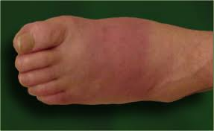
Terminology-Anatomical Directions
Dorsal
Pertaining to the back or rear
The dorsal surface of the left foot got stepped on.

Slide 19
Terminology-Anatomical Directions
Palmar
Pertaining to the palm of the hand
The PALMAR surface had a laceration.

Slide 20
Terminology-Anatomical Directions
Prone
Lying face down
The baby was lying PRONE on the floor.

Slide 21
Terminology-Anatomical Directions
Supine
Lying face up
I usually sleep SUPINE.

Slide 22
Terminology-Anatomical Directions
Deep
Away from the surface
Superficial
On or close to the surface
Superficial
Deep

Slide 23
Opposites that are partners!
Anterior is opposite of ___________________.
Inferior is opposite of ___________________.
Medial is opposite of ___________________.
Distal is opposite of ___________________.
Deep is opposite of ___________________.
Prone is opposite to __________________.
Palmar is opposite to __________________.
Come up to the board and fill in the answers.

Slide 24
The thumb is _________ to the index finger.
The spine is ___________ to the shoulder.
__________ is lying on your stomach.
___________ is lying on your back.
The skin is ____________ to the bone.
The lungs are _________ to the rib cage.
The spine is ___________ to the breast bone.
The head is ___________ to the neck.
The chin is ___________ to the nose.
The elbow is __________ to the fingers.
The toes are __________ to the ankle.
The abs are ___________ to the back.

Slide 25
Terminology-Anatomical Movement
Flexion
To bend or decrease the angle of a joint
Wrist
Elbow

Slide 26
Terminology-Anatomical Movement
Extension
To straighten, increase the angle of a joint
*Restore to anatomical position
Hip
Ankle

Slide 27
Terminology-Anatomical Movement
Abduction
Away from the mid-line
Fingers
Shoulders

Slide 28
Terminology-Anatomical Movement
Adduction
Toward the mid-line

Slide 29
Terminology-Anatomical Movement
Rotation
Movement around a central axis
Internal = Towards the middle
External= Away from the middle

Slide 30
Terminology-Anatomical Movement
Circumduction
Movement in a circular pattern that outlines a cone
A combination of many movements

Slide 31
Terminology-Anatomical Movement
Supination
Rotation of the forearm so that the palm is turned superiorly or anteriorly
How would you hold a bowl of soup?

Slide 32
Terminology-Anatomical Movement
Pronation
Rotation of the forearm so that the palm is turned posteriorly or inferiorly

Slide 33
Terminology-Anatomical Movement
Inversion
Ankle moves so that the plantar surface of the foot is turned inward

Slide 34
Terminology-Anatomical Movement
Eversion
Ankle moves so that the plantar surface of the foot is turned outward

Slide 35
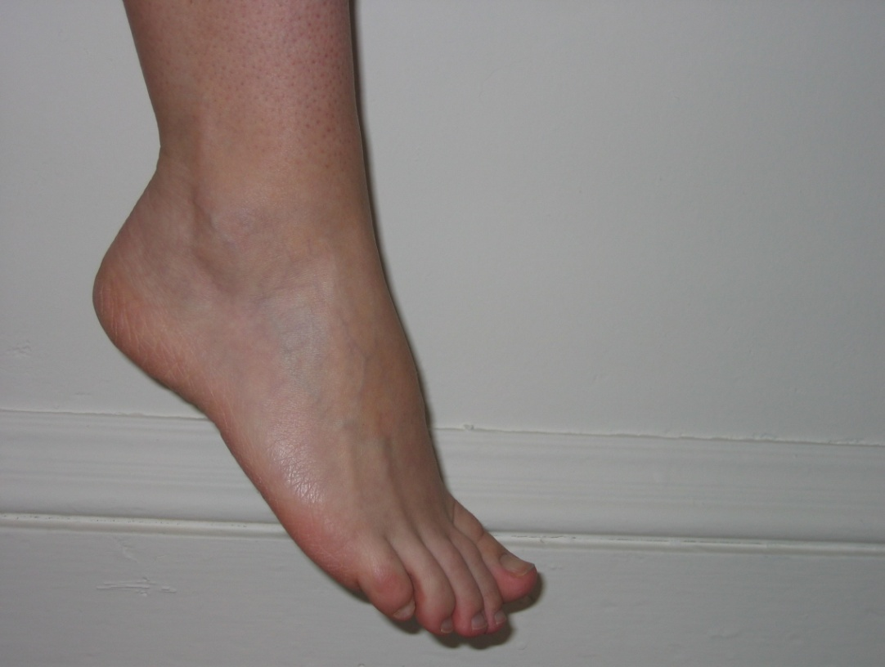
Terminology-Anatomical Movement
Plantar Flexion
Ankle moves so that the plantar surface of the foot is pointed downward

Slide 36
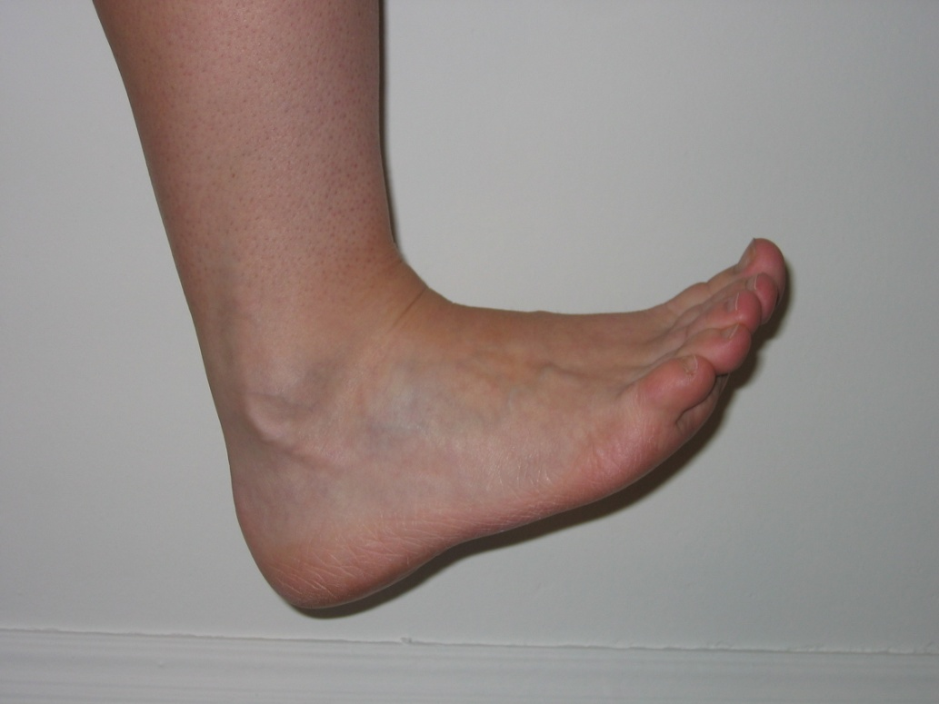
Terminology-Anatomical Movement
Dorsiflexion
Ankle moves so that the dorsal surface of the foot is moved upward

Slide 37
Terminology-Anatomical Movement
Elevation
Raising a body part
Shrug shoulders

Slide 38
Terminology-Anatomical Movement
Depression
Downward movement of a body part

Slide 39
Terminology-Anatomical Movement
Protraction
Movement of a body part forward
Round shoulders –scapula protracts
Push jaw out – mandible protracts

Slide 40
Terminology-Anatomical Movement
Retraction
Movement of a body part backward

Slide 41
Opposites that are partners!
Extension is the opposite of ___________________.
Depression is the opposite of ___________.
Supination is the opposite of ___________.
Retraction is the opposite of ___________.
Eversion is the opposite of __________________.
Adduction is the opposite of ___________.
Internal Rotation is opposite of ___________.
Circumduction makes a ____________________.

Slide 42
Simon Says!
Everyone stand up…
Let’s practice our anatomical movements!!

Slide 43
Terminology Prefix, Suffix & Root
Prefix
Beginning of the word to modify or change its meaning (root)
“Pre” means “before”
Suffix
End of the word that modifies the meaning of the word (root)
Root
Foundation of the word
Central part of a word

Slide 44
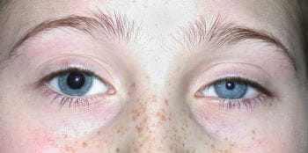
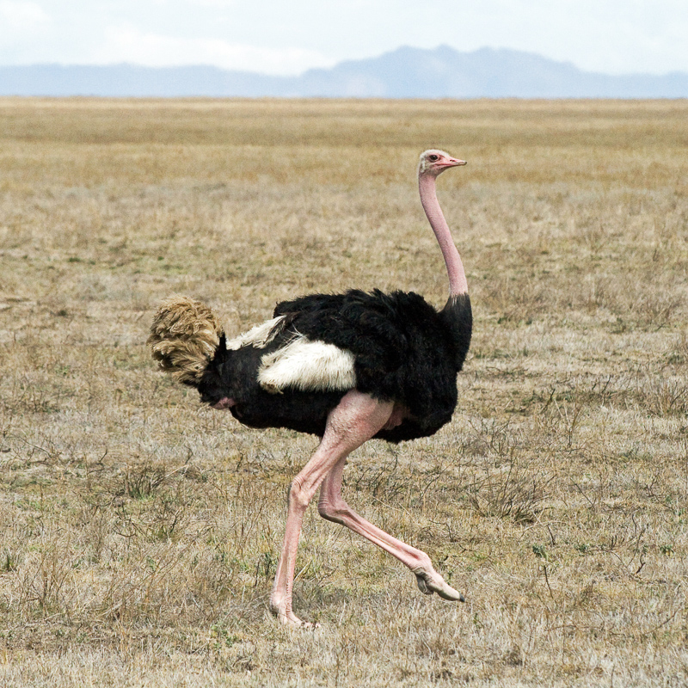
Terminology Prefix Examples
a
absent, without, different
“asymmetrical”
bi
two, both
“bipedal”

Slide 45
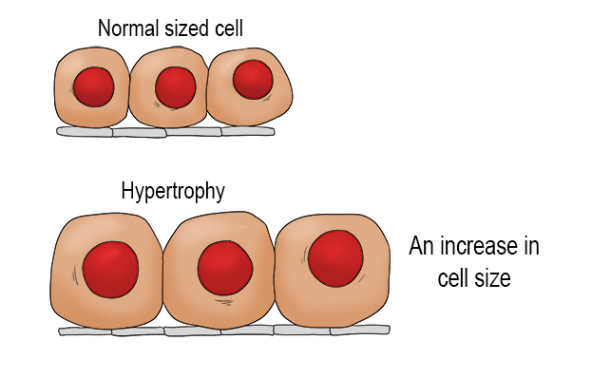
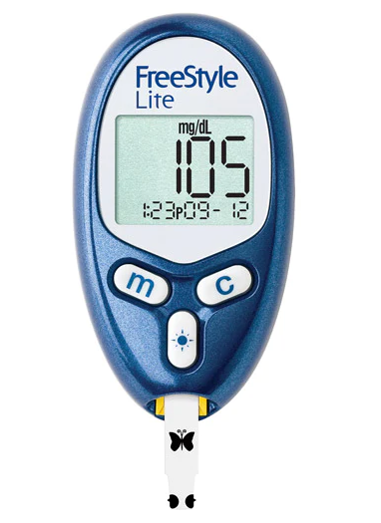
Terminology Prefix Examples
hyper
above, excessive, beyond
“hypertrophy”
hypo
under, deficient, below
“hypoglycemic”

Slide 46
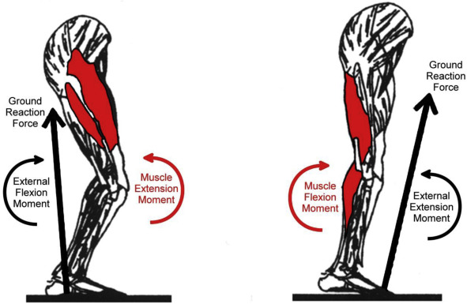
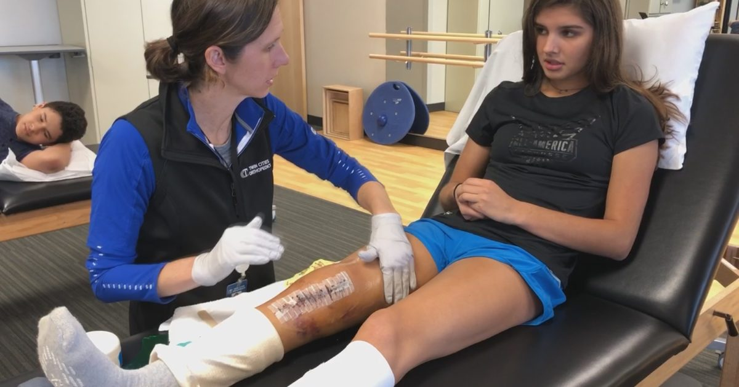
Terminology More Prefixes
ant(i)-
against, opposed to
antagonist
post-
behind, after
post-op
uni-
one
unilateral

Slide 47
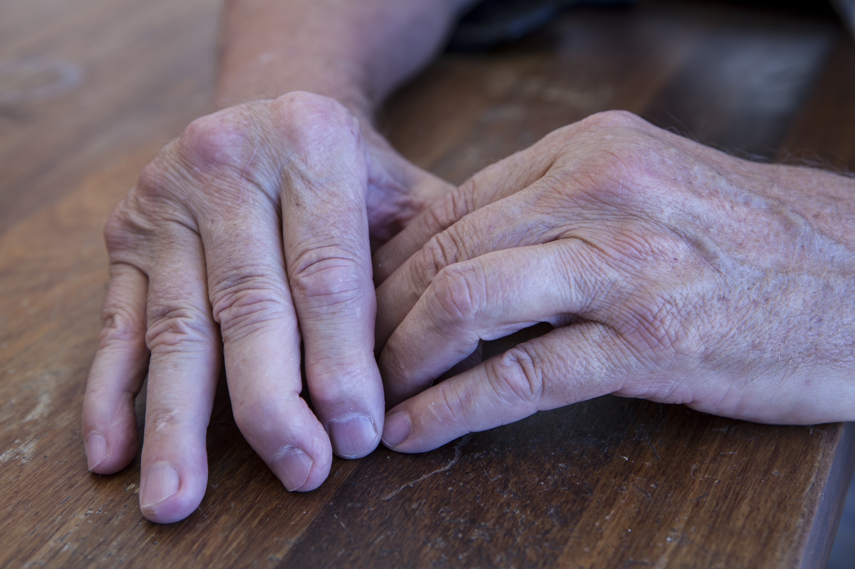
Terminology Root Examples
arthr
joint
“arthritis”
hydr/o
water
“hydrotherapy”

Slide 48
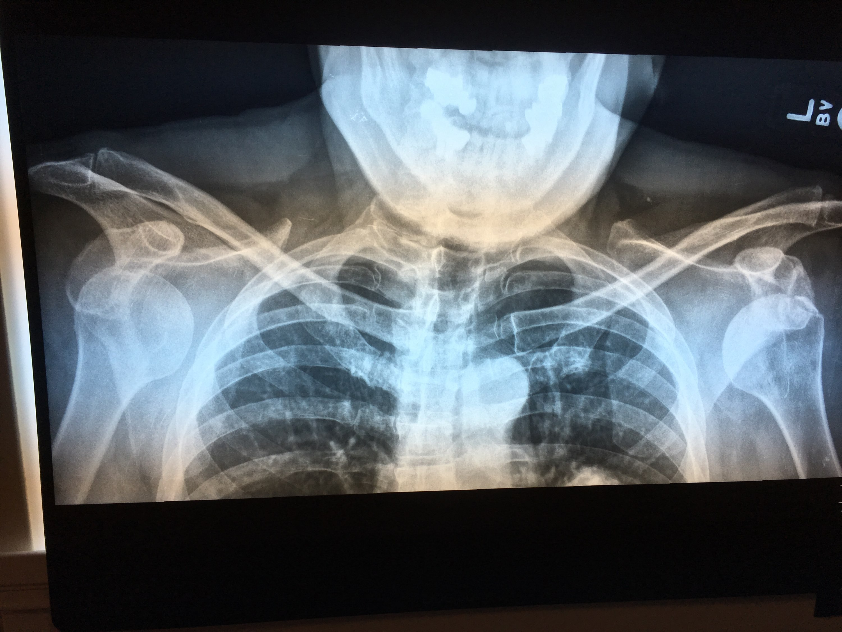
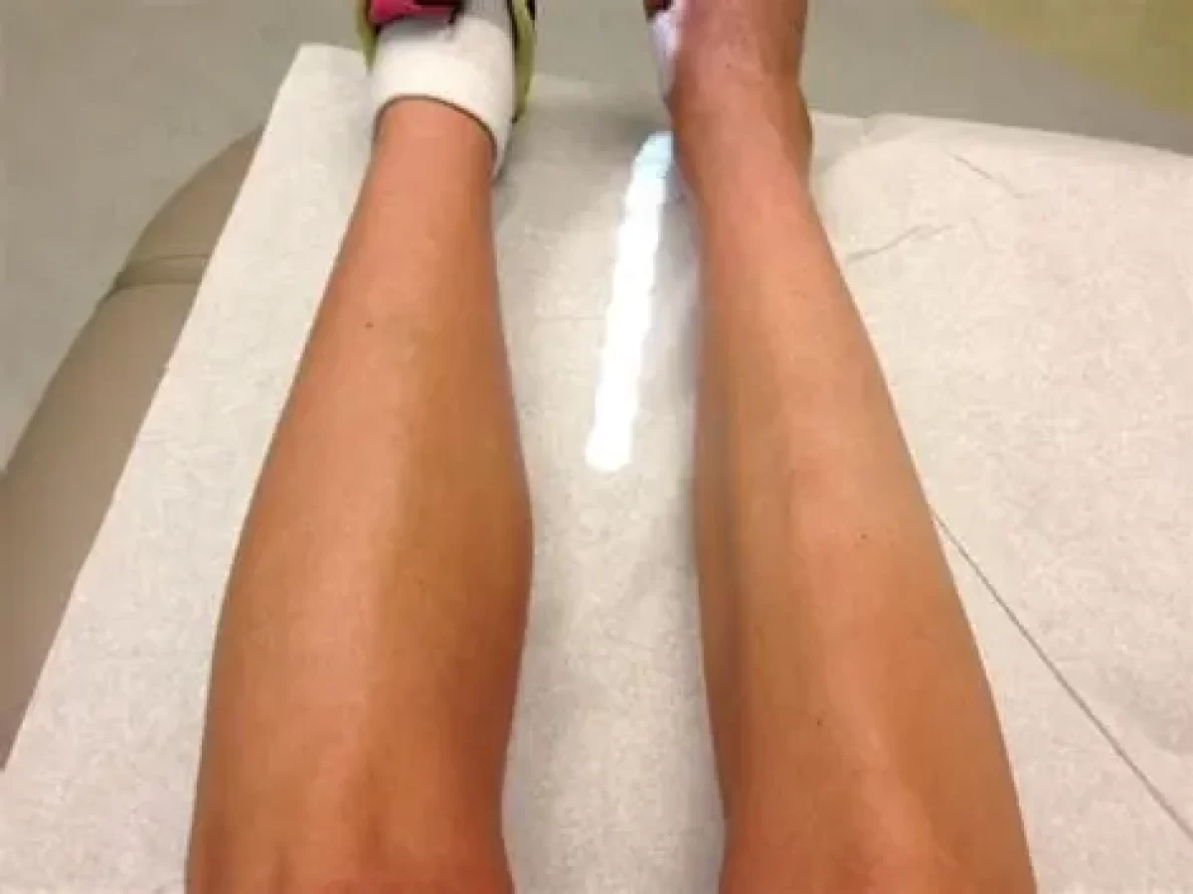
Terminology Root Examples
lateral
to the side
“bilateral”
trophy
growth
“atrophy”

Slide 49
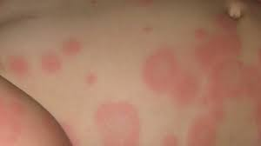
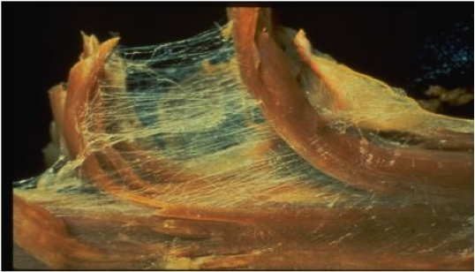
Terminology More Roots
eryth-
red, redness
erythema
derm-
skin
dermatology
my(o)-
muscle
myofascia

Slide 50
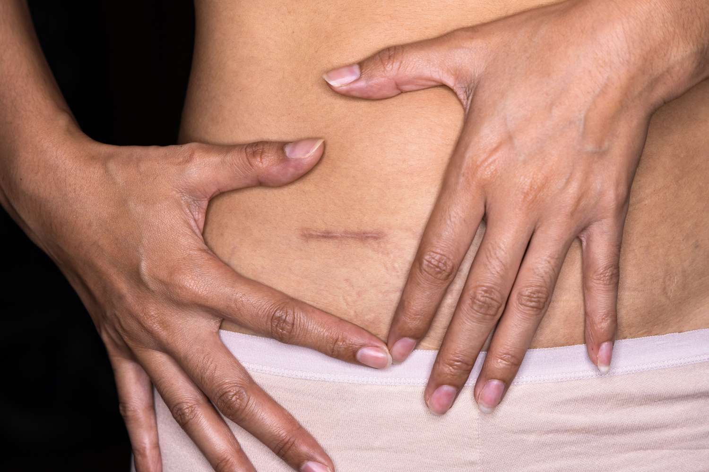
Terminology Suffix Examples
ectomy
surgical removal
“appendectomy”
ia
condition
“hyperthermia”

Slide 51
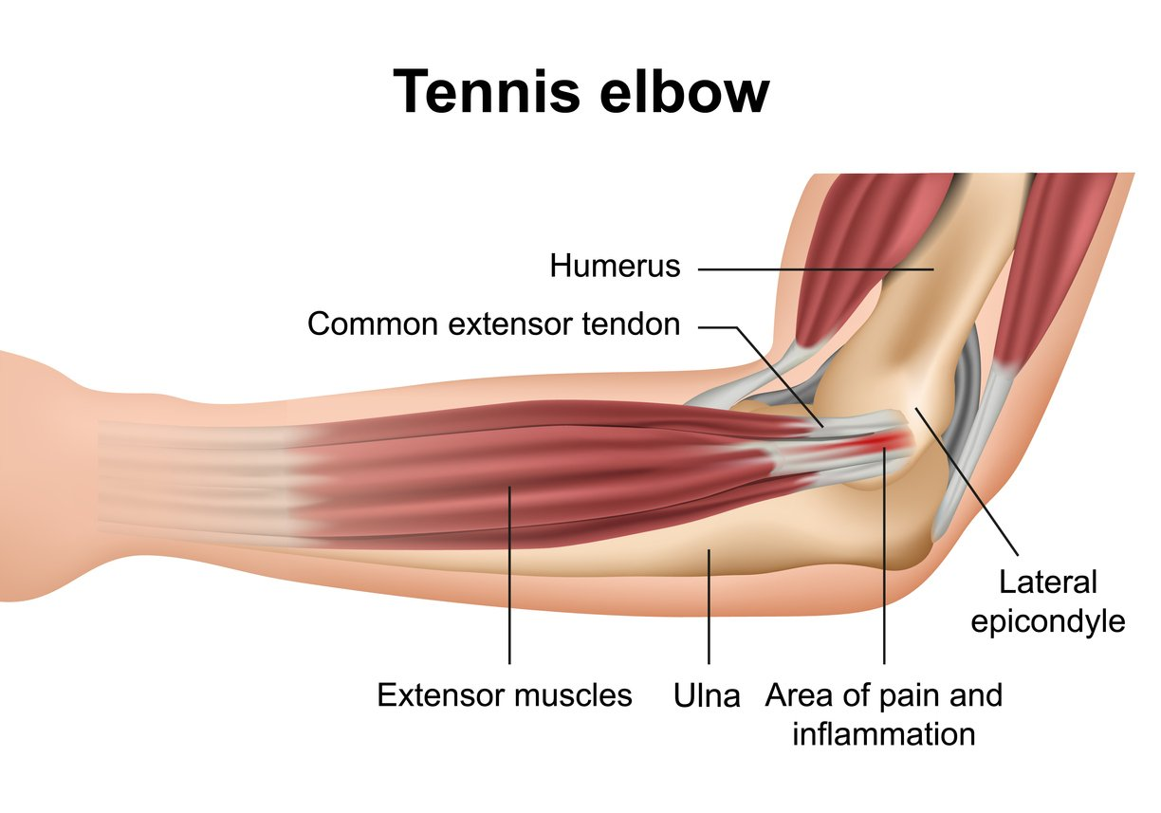
Terminology Suffix Examples
itis
inflammation
“tendinitis”
therapy
treatment
“cryotherapy”

Slide 52
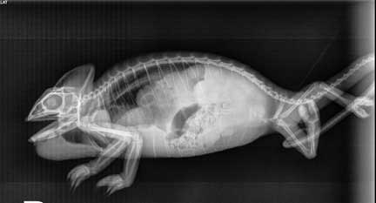
Terminology More Suffixes
-graph
device used to record data
radiograph
-logy
the study of
physiology
-pathy
disease, disorder
neuropathy

Slide 53
Evaluation & Assessment Athletic Injury Terminology
Open Wound
Any injury in which the skin is broken, torn, pierced or cut.

Slide 54
Evaluation & Assessment Athletic Injury Terminology
Incision
A clean, straight cut made by a sharp instrument. An open wound.

Slide 55
Evaluation & Assessment Athletic Injury Terminology
Laceration
A jagged, irregular wound created by a non-cutting object. An open wound.

Slide 56
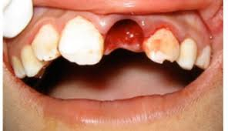
Evaluation & Assessment Athletic Injury Terminology
Avulsion
An injury in which tissue is torn loose or pulled off completely. An open or closed wound.

Slide 57
Evaluation & Assessment Athletic Injury Terminology
Spider Bite
Puncture
An open wound which occurs when a sharp object penetrates through the skin. Generally bleeds very little which increases the chance of infection.

Slide 58
Evaluation & Assessment Athletic Injury Terminology
Amputation
An open wound in which a part is completely cut away from the body, especially by surgery.
Footless Jo on YouTube!

Slide 59
Evaluation & Assessment Athletic Injury Terminology
Closed Wound
Any injury in which the skin remains intact.

Slide 60
Evaluation & Assessment Athletic Injury Terminology
Blister
A closed wound caused by a continuous rubbing or friction over the surface of the skin often resulting in a collection of fluid beneath the skin.

Slide 61
Evaluation & Assessment Athletic Injury Terminology
Hematoma
A closed wound in which bleeding under the tissue or skin results in a swollen area. A collection of blood.

Slide 62
Evaluation & Assessment Athletic Injury Terminology
Contusion
A closed wound in which bleeding occurs under the skin, often resulting in discoloration; a bruise. Caused by a direct blow.

Slide 63
Evaluation & Assessment Athletic Injury Terminology
Sprain
A stretching or tearing of a ligament. An injury to a ligament. A closed wound.

Slide 64
Evaluation & Assessment Athletic Injury Terminology
Strain
A stretching or tearing of a muscle or tendon. An injury to a muscle or tendon. A closed wound.

Slide 65
Evaluation & Assessment Athletic Injury Terminology
Fracture
An injury to a bone in which the tissue is broken or disrupted. A break in a bone. May be open or closed.

Slide 66
Evaluation & Assessment Athletic Injury Terminology
Avulsion Fracture
An injury to a bone in which the tendon pulls a piece of bone off at the attachment. A closed wound.

Slide 67
WRAP IT UP!
Do your best to “translate” these sentences from English to Medical:
1. The athlete has injuries to the outside ligaments on both ankles.
2. Because it was 110° outside, football practice was shortened to prevent overheating.
3. Proper weight training and nutrition can lead to increased muscle growth, while improper techniques typically cause tears or tendon inflammation.

